Slide 1
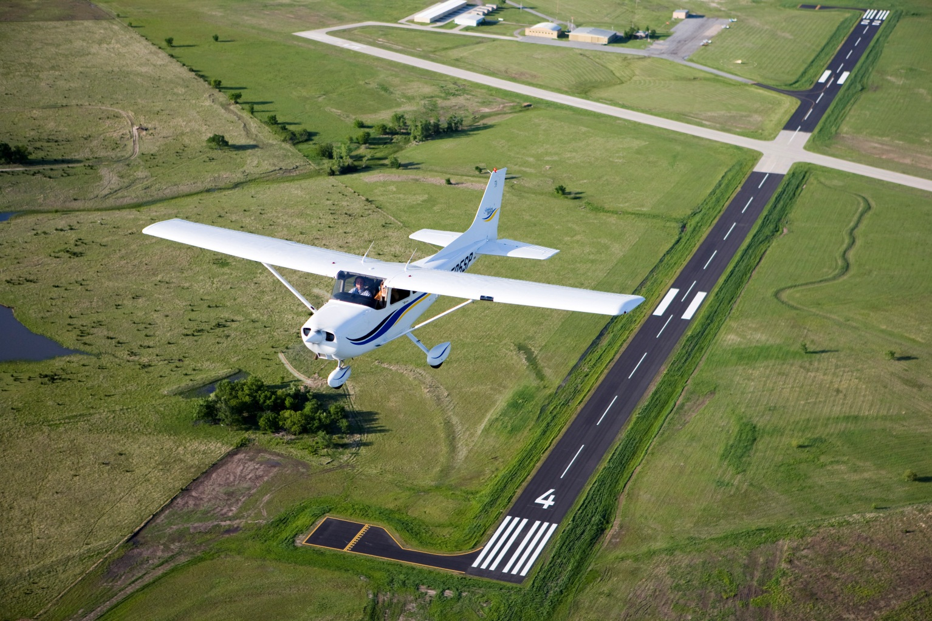
Your Future In Aviation

Slide 2
What is GA?
General Aviation
All things aviation except military and the airlines
BUT IT IS SO MUCH MORE THAN THAT…

Slide 3
What is GA?
Business flying
Law enforcement
Firefighting
Sightseeing
Package delivery
Air ambulance
News/traffic
reporting
Agricultural
Wildlife
management
Recreational
flying
Disaster relief
Banking/Commerce

Slide 4
Is Flying Safe?
Pilot training is very rigorous
Recurrent training is required by the FAA to maintain and improve skills
All aircraft must have an extensive annual inspection

Slide 5
Who are GA Pilots?
Ordinary people…
with a business need, civic duty, or just plain passion for flying
Over 600,000
CERTIFICATED PILOTS IN THE U.S.

Slide 6
What Can I Fly?
GA aircraft come in all shapes and sizes, and can vary in power and performance.
You will probably learn to fly in a small single engine aircraft...
…LIKE THIS ONE

Slide 7
How About Something Fast?
And someday, you can be soaring across the country in this

Slide 8
Why Not A Blimp?
The MetLife blimp needs pilots, too!

Slide 9
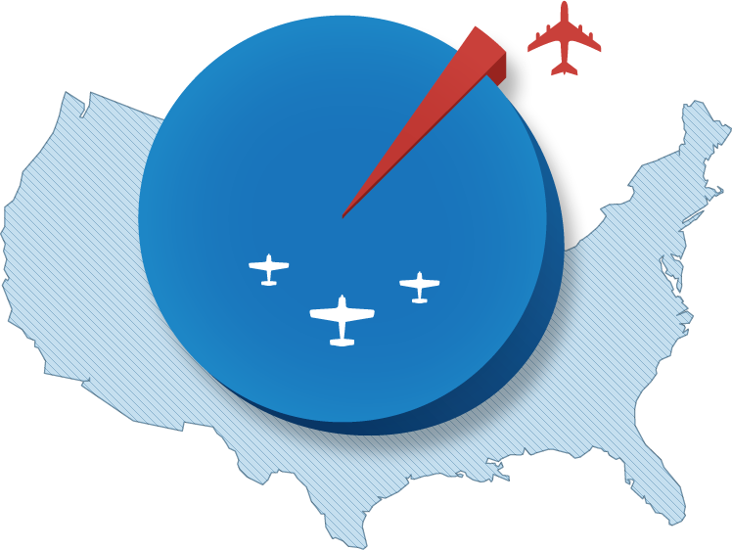
Where Can I Fly?
Of the more than 5,000 public airports in the U.S., only 500 have airline service

Slide 10
What Can I Expect to Find at an Airport?
Flight School
A Restaurant
Fixed Base
Operator (FBO)
Air Traffic
Control Tower

Slide 11
Flying for Fun
Fly your friends to lunch
Go visit family for a weekend

Slide 12
How About a Career in Aviation?
Do you…
Like math and science?
Enjoy using your imagination?
Like to know how things work?
Want to invent or improve something?
Enjoy providing a service and helping those in need?

Slide 13
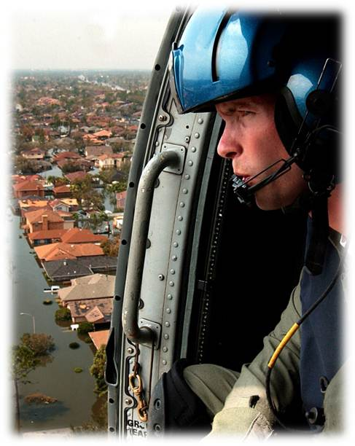
What Kinds of Aviation Jobs are Available?

Slide 14
What Kinds of Aviation Jobs are Available?
Aircraft Mechanic
Requires FAA certification
Work in aircraft hangars or on a flight line
Repair, inspect, and test aircraft systems

Slide 15
What Kinds of Aviation Jobs are Available?
Engineer
Requires college degree
Variety of Types
Aircraft Design
Flight Test
Propulsion (Engines)
Avionics

Slide 16
What Kinds of GA Jobs Are Available?
Flight Instructor
Requires FAA certification
Train the next generation of pilots
Fun and rewarding

Slide 17
What Kinds of Aviation Jobs are Available?
Air Ambulance Pilot
Carry injured or sick people for emergency medical care
Fly specially equipped aircraft

Slide 18
What Kinds of Aviation Jobs are Available?
And many more…
Air Traffic Controller
Meteorologist
Airport Manager
Flight Operations Manager
Flight Attendant
Manufacturing/Fabrication
Sales

Slide 19
How Can I Work Toward a Career in Aviation?
Stay in school
Develop good study habits
Talk to professionals in aviation
Go to your local airport

Slide 20
I Think I Might Like to Learn to Fly …Now What?
Find a flight school near you
Ask questions
What is the curriculum?
How long will it take to learn?
What is the cost?
How can I build flight time?
GET A FREE AOPA MEMBERSHIP AT WWW.AOPA.ORG/AV8RS

Slide 21
Funding for this presentation made possible through a grant from the AOPA Foundation
WWW.AOPA.ORG/FOUNDATION
WWW.AOPA.ORG

