Slide 1
The National FAA Safety Team Presents
Topic of the Month – April
Stabilized Approach and Go-around
<Audience>
<Presenter>
< >
Notes:
2023/10-29-300(I)PP Original Author: J. Steuernagle March 2017 POC: K. CloverAFS-850 Operations Lead Office 562-888-2020 Revised by John Steuernagle April 2025
Presentation Note: This is the title slide for Stabilized Approach and Go-around.
Presentation notes (stage direction and presentation suggestions) will be preceded by a Bold header: the notes themselves will be in Italic fonts.
Program control instructions will be in bold fonts and look like this: (Click) for building information within a slide; or this: (Next Slide) for slide advance.
Some slides may contain background information that supports the concepts presented in the program.
Background information will always appear last and will be preceded by a bold Background: identification.
We have included a script of suggested dialog with each slide. Presenters may read the script or modify it to suit their own presentation style.
The production team hope you and your audience will enjoy the show. Break a leg!
(Next Slide)

Slide 2
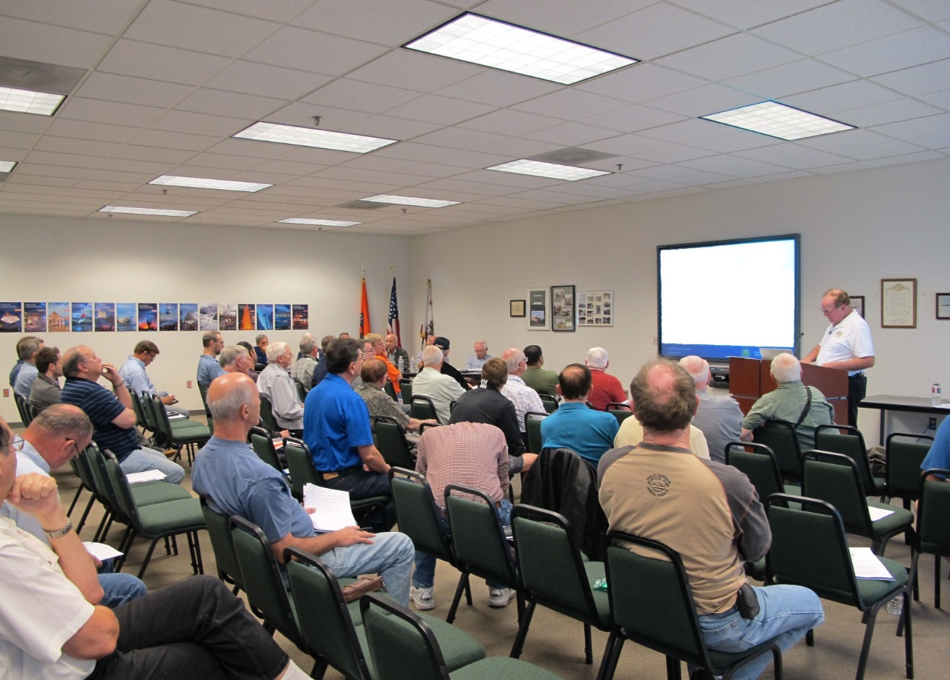

Welcome
Exits
Restrooms
Emergency Evacuation
Breaks
Sponsor Acknowledgment
Set phones & devices to silent or off
Other information
Notes:
Presentation Note: Here’s where you can discuss venue logistics, acknowledge sponsors, and deliver other information you want your audience to know in the beginning.
You can add slides after this one to fit your situation. (Next Slide)

Slide 3
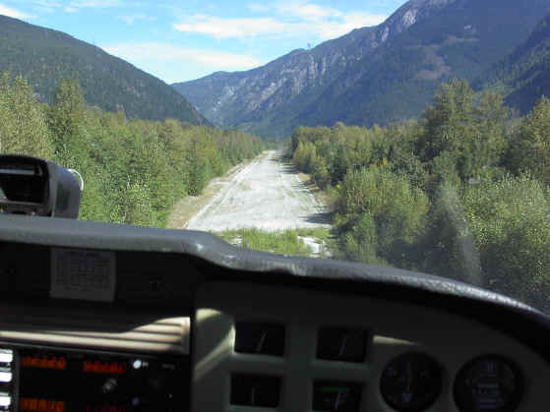
Overview
Loss of Control Accidents
Loss of Control Work Group Recommendations
Stabilized Approaches
Go-arounds
Tips and Tricks
Notes:
In this presentation we’ll talk a little bit about Loss of Control Accidents and recommendations from the General Aviation Joint Safety Committee work group that studies loss of control. We’ll define and discuss stabilized approaches and go-arounds. Finally, we’ll give you some tips and tricks that will help you to avoid loss of control in any aircraft.
Presentation Note: If you’ll be discussing additional items, add them to this list
(Next Slide)

Slide 4
Fatal LOC Accidents
Notes:
In a recent 10-year period there were more than 1200 Fatal Loss of Control accidents. (Click)
The second largest group of Fatal Loss of Control accidents occurred during the approach phase of flight – think stall/spin/crash – and many of those accidents resulted from an un stabilized approach or a failure to go around.
(Next Slide)

Slide 5
LOC Workgroup Findings
Lack of single – pilot CRM skills
Un stabilized approaches
Inappropriate go-around procedures
Flight after extended periods of not flying
Insufficient transition training
Over reliance on automation
Flight after use of drugs
Lack of Aeronautical Decision-making Skills
Notes:
Here are some findings of a recent study of Loss of Control accidents. Most fatal GA Loss of Control accidents have one or more of these causal factors. (Click)
We’ll focus on Un stabilized approaches and go-arounds (Click)
But we’ll also touch on Over reliance on automation and Aeronautical Decision Making.
(Next Slide)

Slide 6
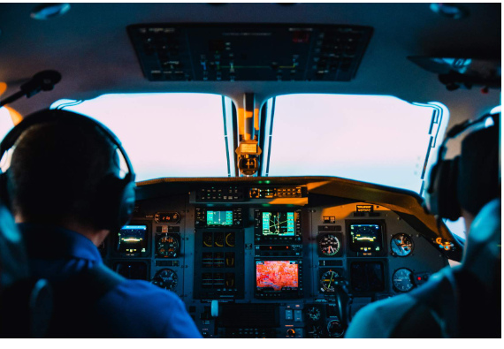
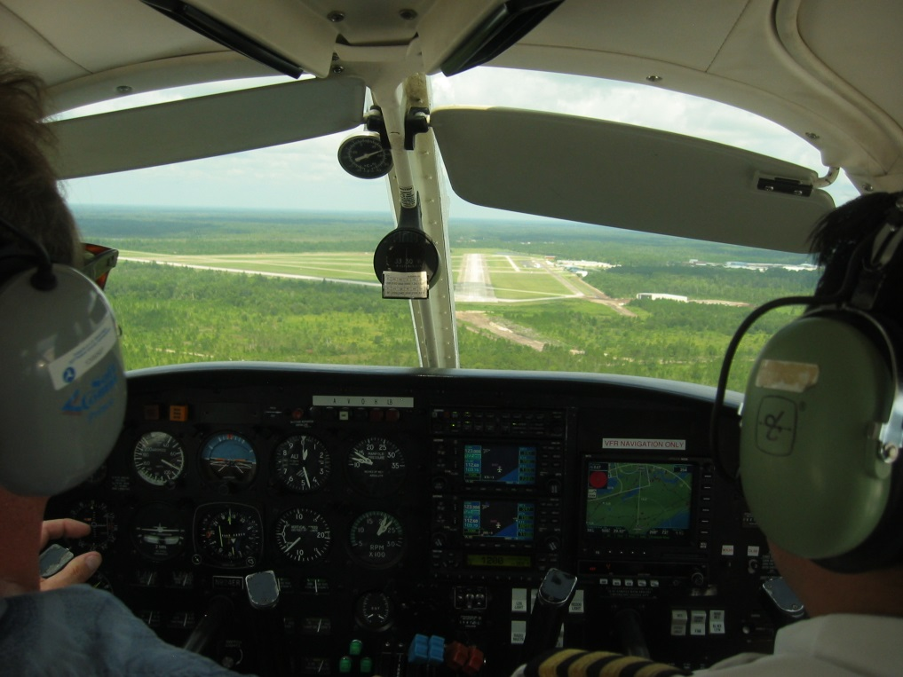
Instruments and VFR
Notes:
Pilots often think of stabilized approaches in terms of instrument flying in large airplanes (Click)
but they’re equally important to VFR pilots in smaller aircraft.
Either way, what you want is a constant speed and a constant descent rate that will get you from a given point to the touchdown zone with a minimum of maneuvering.
That’s important because the stabilized approach will safely get you in the best position to land with the least amount of work to do when you get there.
(Next Slide)

Slide 7
Parameters - IFR
Stabilized by 1000 feet above touchdown elevation.
  On correct flight path
    Small corrections to maintain
  On speed
    Recommended approach speed
      +10/-5 knots or MPH
  Descent
    On Glide Slope/VASI
    500 fpm or less
  In landing configuration
  Landing checklist complete
Notes:
We’ll begin with a discussion of instrument approach operations. VFR and pattern operations will come a little later.
For instrument operations we want to be stabilized no lower than 1000 feet above the runway, on the correct flight path to the touchdown zone. That means we’re on a direct course from 1000 feet to the airport. We use a power setting that will yield the recommended approach speed for our aircraft in landing configuration.
In the descent department, maintain the glide slope if you’re landing on a precision approach runway or not more than a 500 foot per minute rate of descent unless a greater descent rate is required for approach. We’re stabile if we make only small corrections in pitch, heading, and power to maintain the path. Before you’re 1000 feet above touchdown you also need to be configured for landing with the landing checklist complete.
Many instrument pilots want to have all this done by the time they reach the final approach fix. They’ll generally be a little higher than 1000 feet at that point but it’s a good practice that will give you plenty of time to concentrate on flying to the missed approach fix.
If the wind is gusting, we can add some speed to compensate but no more than half of the gust factor. If the wind is at 12 knots and gusting to 18, we can add 3 knots to our final approach speed.
So what if we’re not stabile by the time we descend to within 1000 feet of the runway? Well, the answer is simple – we go around and set up a more stabile approach on the next try. This can be a tough decision to make, especially if you must make another instrument approach. That’s why you have to be committed to the decision before you reach the 1000-foot point. Then it’s simple: if you’re stabile you continue – if not; go around and set up again.
Presentation note: Ask the audience about their best practices and at what point in the approach they are configured and stabile.
(Next Slide)

Slide 8

Parameters - VFR
Stabilized by 500 feet above touchdown elevation.
  On correct flight path
    Small corrections to maintain
  On speed
    Recommended approach speed
      +10/-5 Knots or MPH
  Descent
    On Glide Slope/VASI
    500 fpm or less
  In landing configuration
  Landing checklist complete
Notes:
VFR parameters are essentially the same except that you can get a little closer to the ground before making the go around decision. If you’re flying a pattern you need to be stable on final, in landing configuration with the landing checklist complete. If you’re not stabile at 500 feet – go around.
Presentation note: Ask the audience about their VFR best practices and at what point in the approach they are configured and stabile.
(Next Slide)

Slide 9

Parameters IFR and VFR
In addition to the parameters on the previous 2 slides think Go-around and make that part of your approach briefing.
Go-around/Missed Approach Procedures. Frequency after declaring intentions, Destination? VOR, NDP, Intersection. Heading, Altitude, Power Setting.
A stabilized approach will give you the time to plan for a Go-around as well as you planned for your Initial T/O.
Notes:
If you think we’re talking a lot about go-arounds; you’re right. If you accept the fact that stabilized approaches give you the best chances of making excellent landings, it’s also true that go-arounds are your best defense against landing accidents.
(Next Slide)

Slide 10
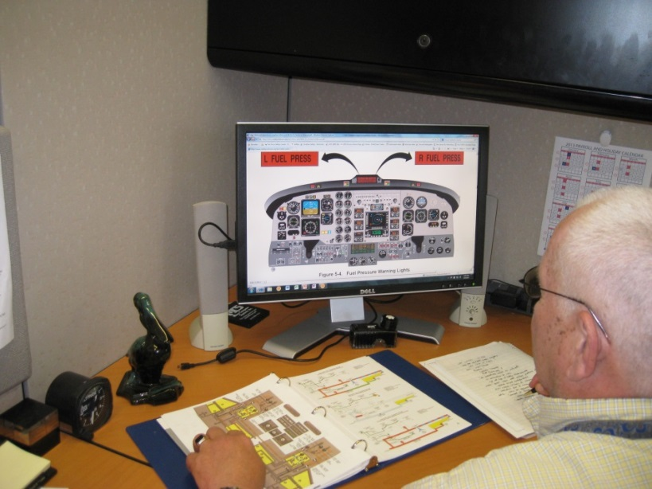
Read the book
Pilot’s Operating Handbook or AFM
Performance Charts
Speeds for safe operation
Emergency procedures
Systems
Notes:
I know we cited some general performance numbers in the previous slides but what speeds and configurations do you use for your flying machine?
Obviously, the place to go is the POH. You’ll want to study your performance charts, speeds for safe operation, systems, and emergency procedures.
Have your speeds and configurations data memorized so you don’t have to check the book in the middle of a high workload evolution.
(Next Slide)

Slide 11
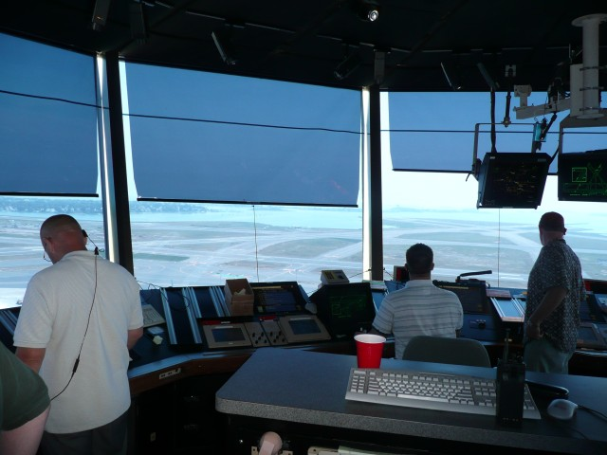
De stabilizing factors
Excessive Speed
Excessive Altitude
Maneuvering
ATC and traffic
Notes:
Excessive speed, excessive altitude, and the necessity for maneuvering can all contribute to a de-stabilized approach.
Obviously entering the pattern at 150 knots or just above stall speed, or 1000 feet above the pattern altitude, or major heading changes make a stabilized approach unlikely if not impossible. But how often have you heard this from a tower? (Click) “Cessna 43 Kilo Charlie keep your speed up to the marker. Faster traffic to follow.” Or how about this? “Piper 312 Victor Papa make an S Turn on final. Traffic departing.” Or how about a Bonanza following a J3 Cub on final at a non-towered airport?
ATC and other traffic in the vicinity can destabilize your approach if you let them. If following traffic or complying with ATC instructions will destabilize your flight it’s time to exercise your pilot in command responsibility; say, “unable” and make another plan.
Presentation note: Discuss these and other situations that might lead to an un stabilized approach. Ask the audience how they cope with de stabilizing circumstances. How many have exercised their pilot in command authority to say, “unable”
(Next Slide)

Slide 12
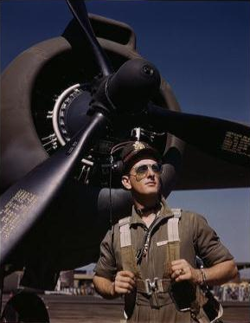
It’s hard to say, “unable.”
Skilled
Competent
Adaptable
Accommodating
Rise to the Occasion
Mission Oriented
  Git er done
Notes:
Let’s face it. It’s hard to say unable. Pilots need to have a good self image in order to do what we do, and we care a lot about how others see us. We take justified pride in our skills and competencies that enable us to be adaptable and accommodating; to rise to the occasion if need be. We’re also mission oriented, and we’ll do almost anything to, “get er done.”
That’s a formula for success – most of the time – but as the song says, “you’ve got to know when to hold em, know when to fold em, know when to walk away, and know when to run.” It’s fine to be all of these things but when your approach is becoming unstable, it’s time to Get out of Dodge. There’s no shame in missing an approach or going around. Great pilots anticipate the need and they do it frequently.
Presentation note: Discuss pressures to succeed and salvage the approach and how the audience deals with them. Then ……..
Oddly enough, flight instructors can be a part of the problem and here’s how that works.
(Next Slide)

Slide 13
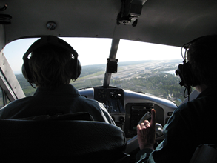
Part of the problem?
CFI’s can, and often do, salvage student approaches
Taking control can:
  Salvage the landing or approach
  Save time and money
  Keep the training on schedule
  Impress the student
    And maybe the boss
But it may send the wrong message
  Let the student go around and then
  Validate their good judgment
Notes:
Let’s face it – Instructors are very good plane handlers. They can easily salvage a student-induced de stabilized approach and make a perfect landing – usually. (Click)
When we take control, we salvage the situation, saving time and money. We get the airplane back on time for the next student. Our performance definitely impresses our students and, with luck, even the boss. (Click)
But it’s sending the wrong message. Watching us fix a problem they’ve created, students begin to believe that, with the right skills, they can fix anything, and they look forward to the day when they can equal their instructor’s skill. Many students believe they’ll get there sometime next week.
Your students will get into impossible situations, and you’ll want to take over, but you do them a disservice if you fix the problem. Allow them to analyze the situation, miss the approach, or go around and when they do that; reward them for excellent aeronautical decision making.
(Next Slide)

Slide 14
So, when do I go-around?
Whenever the approach becomes unstable
  At or below 1000 ft – IFR
  At or below 500 ft – VFR
Whenever a landing can’t be made
  Runway out of service
  Traffic on runway
Make the decision early
  Stick to it!
    Changing your mind is destabilizing
Notes:
So, when do I go around? (Click)
If you’re at or below 1000 ft IFR – or 500 ft VFR and the approach isn’t stabile, it’s time to miss the approach or go around. (Click)
Likewise, if the runway you’re approaching is out of service or there’s traffic on it that won’t be clear when you get there it’s also time to go around. (Click)
Whatever the situation, the earlier you make the go around decision the easier it will be and once you’ve decided to go around; stick to that decision. Changing your
mind after you’ve started the maneuver is bound to be destabilizing and you’re too close to the ground for that.
(Next Slide)

Slide 15
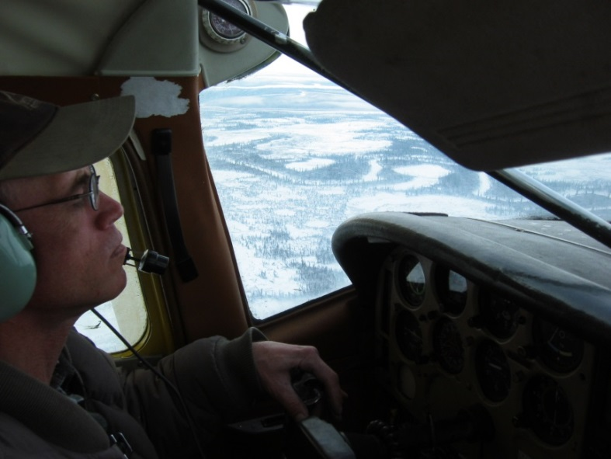
Go-around & Missed Approach
Priorities
Aviate
  Maintain aircraft control
  Arrest descent
  Apply climb or level flight power
  When you have a positive rate
  of climb, Configure flaps,
  gear, etc. for climb or level
  flight.
Notes:
When missing an approach or going around you’re usually pretty close to the ground so your first priority is to maintain aircraft control. Arrest your descent, apply power to maintain altitude or climb as appropriate, and configure the airplane for climb or level flight.
(Next Slide)

Slide 16
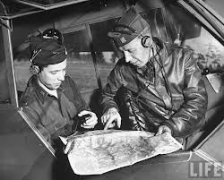
Go-around & Missed Approach
Priorities
Navigate
  IFR Continue to missed approach point and then
    Fly the missed approach procedure or
    Follow ATC instructions
  VFR Continue to runway threshold & climb to pattern altitude and then
    Maneuver to remain in or re-enter pattern or
    Follow ATC instructions
Notes:
With the aircraft under control and not descending it’s time to navigate. If you’re IFR, continue to the missed approach point and then either fly the published missed approach procedure or follow ATC instructions.
VFR - continue to the runway threshold while climbing to pattern altitude then either maneuver to remain in or reenter the pattern or follow ATC instructions as appropriate.
(Next Slide)

Slide 17
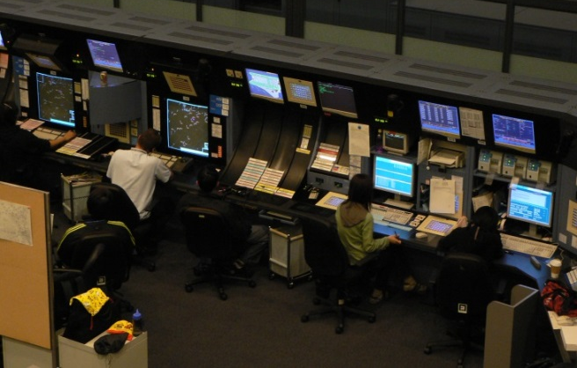
Go-around & Missed Approach
Priorities
Communicate
  IFR
    Tower or local traffic advisory frequency
    ATC – state intentions
  VFR
    Tower or local traffic advisory frequency
Notes:
When we’re satisfied, we’re safely aviating and navigating it’s time to let other folks in on our plans. Communicate your intentions to ATC if IFR or in a towered environment. IFR operations to non-towered airports require a call to ATC and perhaps a call on the common traffic advisory frequency.
VFR will be one call only on the tower frequency or local traffic advisory frequency as appropriate.
(Next Slide)

Slide 18
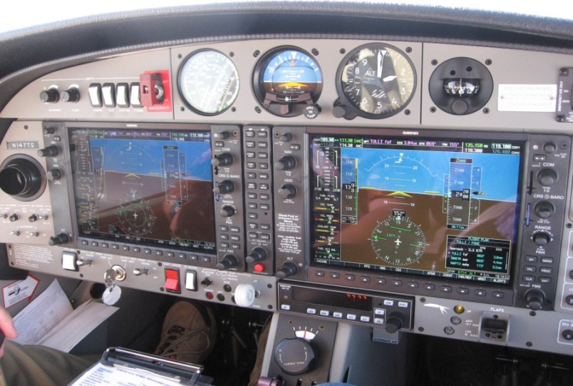
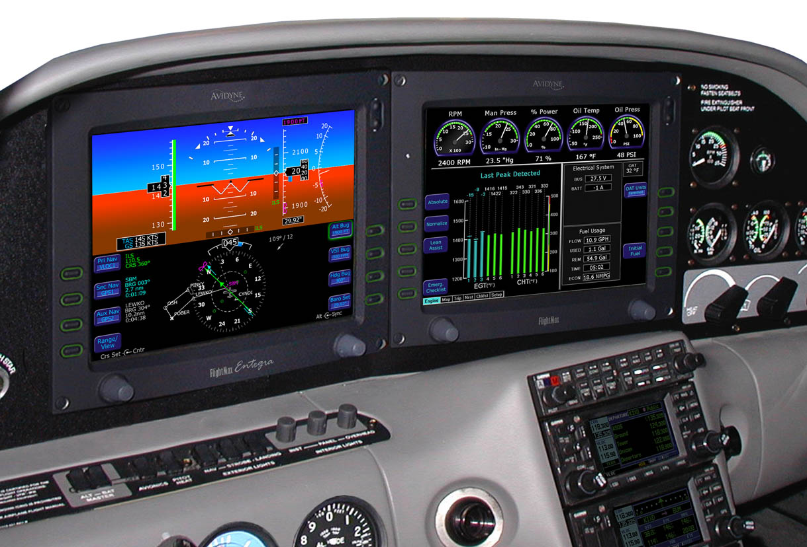
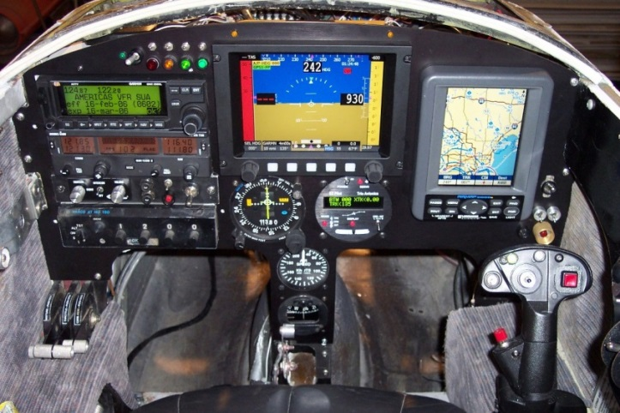
The Automation Paradox
Notes:
For many years we’ve been developing automation for general aviation pilots and we’ve encouraged pilots to use it. That’s led to a reduced “hands on” workload and increased situational awareness. Those are good things. But paradoxically, reliance on automation is beginning to erode basic pilot skills and, when the situation calls for pilots to take over, they’re often not performing as well as they would have if they were hand flying all along.
We recommend that pilots be familiar with and comfortable in operating all the automation in the airplanes they fly. But we also recommend that they practice hand flying regularly so, when the occasion arises, they’ll be on top of their game.
This is a good subject to explore in refresher training.
Presentation Note: Poll audience as to what sort of instrumentation they’re flying. If there are glass cockpit aviators in the audience, ask them to talk about their hand flying experience and what ratio of hand to automated flying they recommend.
(Next Slide)

Slide 19
The Automation Paradox
Something to consider when flying “Electric Aircraft”
As Situational Awareness increases with Automation, “Stick and Rudder proficiency can decrease due to “letting George do it”
Hand Fly Departures and Arrivals whenever possible
Notes:
Just because we have a great avionics suite and autopilot doesn’t mean we can neglect our hand-flying skills. They may be needed at any time so
it makes sense to keep them honed. We encourage pilots to hand-fly departures, climbs, descents, and arrivals regularly.
(Next Slide)

Slide 20
Tips and Tricks
PLAN for the missed approach or go around
Preset the frequencies you’ll need
Manage Distractions
Practice missed approaches & go-arounds
So that they become second nature.
Seek refresher training
  Annually
    WINGS Pilot Proficiency Program
  When returning to flying after period of inactivity
Notes:
Finally, here are some tips and tricks to help you avoid a loss of control accident: (Click)
Plan to miss or go around
You should plan for and brief (if appropriate) the missed approach or go around for each and every approach. Know where you’ll make the decision and miss or go around at that point. Don’t second guess yourself. This is the time to stand by your decision. (Click)
Preset the frequencies you’ll need
Planning for misses or go-arounds also involves setting up your nav and comm radios in anticipation of these events. This is pretty easy with today’s radios that store multiple frequencies but even if you have one frequency to work with you can list the frequencies in sequence on your knee board or scratch pad. That way you won’t have to go searching for them in a high workload phase of flight. (Click)
Manage Distractions
Learn to manage distractions – especially while maneuvering close to the ground.
Maintain a sterile cockpit while in departure, approach, and landing flight segments and while maneuvering.
Make sure your aircraft is stable before copying ATC instructions, changing charts, reviewing approach, etc.
Assign the 2nd pilot or a passenger to help you scan for traffic.
You can often turn distracting passengers into assets by assigning them a job to do.
Presentation Note: Ask audience about how they manage distractions. Relate additional things you do to keep distractions to a minimum. (Click)
Practice Missed Approaches and Go-arounds
Don’t wait until you have to do it for real to practice these maneuvers. At least once a quarter fly a missed approach. Pick one that requires pilot navigation – not just vectors for another approach. If your usually vectored to final for most of your approaches you should practice a complete approach procedure without vectors quarterly too.
The same is true for go-arounds. It’s a good idea to practice them from time to time as well. Going around, re entering the pattern, collision avoidance, and communicating your intentions really increases pilot workload and, with practice, you’ll look like a pro when you have to do it for real. (Click)
Seek regular refresher training.
We suggest you do annual refresher training at a minimum – more frequently if you’re new to flying – and when returning to flying after a lay off. Ask your CFI to include full approach procedures and misses as well as a go-around or two.
The WINGS Pilot Proficiency Program is a good place to document your training.
(Next Slide)

Slide 21
Stabilized approaches are essential to safe _________ flying.
Advanced
Instrument
Private
VFR
Notes:
Presentation Note: Ask the audience to answer this question. When they have answered; click to reveal the correct answers.
Now for a quick review:
Stabilized approaches are essential to safe – blank - flying:
A stabilized approach is essential to (Click) instrument and (Click) VFR flying. (Click)
And it matters not whether you’re an airline pilot with thousands of hours or a Private pilot just starting out, so this is definitely an “all of the above” question.
(Next Slide)

Slide 22
After you begin a go around you can change your mind but only once.
True
False
Notes:
Presentation Note: Ask the audience to answer this question. When they have answered; click to reveal the correct answers.
After you begin a go around you can change your mind but only once (Click) This is false. Changing you mind and trying to complete a landing after you’ve started the go around is de-stabilizing. You’re better off to complete the go-around and return for another landing attempt.
(Next Slide)

Slide 23
Flight Instructors should demonstrate how to salvage unstable approaches.
True
False
Notes:
Presentation Note: Ask the audience to answer this question. When they have answered; click to reveal the correct answers.
Flight Instructors should demonstrate how to salvage un-stabile approaches.
(Click) False – This practice, though common, is usually not recommended. If CFIs always take over and stabilize the approach or complete the landing; students don’t get to make the go-around decision. Nor do they get practice in go-arounds. As certificated pilots they may be less inclined to exercise the go-around option and that has contributed to a significant number of approach and landing accidents.
(Next Slide)

Slide 24
The order of priority in executing a missed approach or go-around is:
Communicate, aviate, navigate
Aviate, communicate, navigate
Aviate, navigate, communicate
Notes:
Presentation Note: Ask the audience to answer this question. When they have answered; click to reveal the correct answers.
The order of priority in executing a missed approach or go-around is: (Click)
C – Aviate, navigate, communicate. It’s true that all of these things happen at nearly the same time but your first priority is to fly the airplane, followed by navigating so as to avoid impacting terrain. Once you’ve got those under control, it’s time to communicate your intentions.
(Next Slide)

Slide 25
Good practices to achieve stability are:
Managing Distractions
Seeking Refresher Training
Pre-setting frequencies
Practicing missed approaches and go-arounds
Participation in “Wings”
All of the above
Notes:
Presentation Note: Ask the audience to answer this question. When they have answered; click to reveal the correct answers.
Good practices to avoid Loss of Control are: (Click)
All of the above.
(Next Slide)

Slide 26
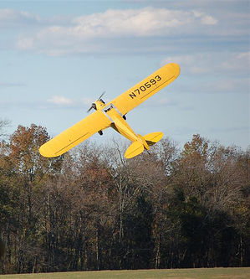
Questions?
Notes:
Presentation Note: You may wish to provide your contact information and main FSDO phone number here. Modify with
Your information or leave blank.
(Next Slide)

Slide 27
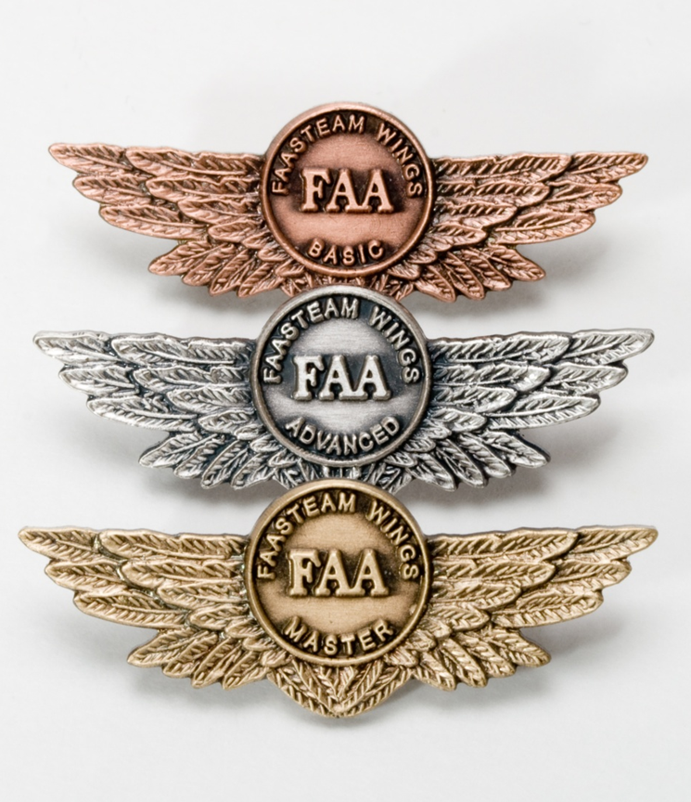
Proficiency and Peace of Mind
Fly regularly with your CFI
Perfect Practice
Document in WINGS
Notes:
There’s nothing like the feeling you get when you know you’re playing your A game and in order to do that you need a good coach (Click)
So fly regularly with a CFI who will challenge you to review what you know, explore new horizons, and to always do your best. Of course you’ll
have to dedicate time and money to your proficiency program but it’s well worth it for the peace of mind that comes with confidence. (Click)
Vince Lombardi, the famous football coach said, “Practice does not make perfect. Only perfect practice makes perfect.” For pilots that means
flying with precision. On course, on altitude, on speed all the time. (Click)
And be sure to document your achievement in the Wings Proficiency Program. It’s a great way to stay on top of your game and keep you flight review current.
(Next Slide)

Slide 28
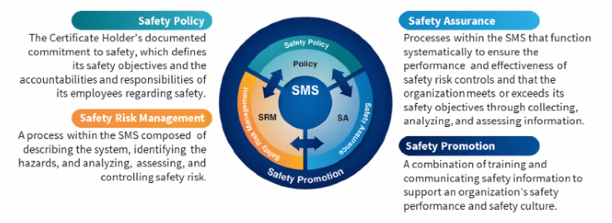
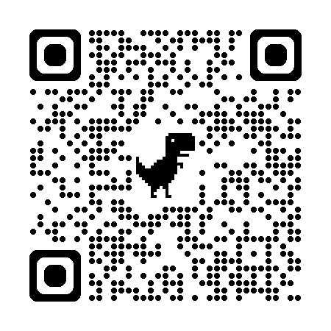

Safety Management Systems (SMS)
Coming to General Aviation
https://www.faa.gov/about/initiatives/sms
Notes:
Safety Management Systems are a set of policies and processes that can increase the safety and efficiency of any flight operation. And FAA is bringing SMS to General Aviation. You may have heard of SMS but thought it was only for large organizations but actually SMS can be scaled to fit any operation large or small.
There are 4 major components to a Safety Management System (Click)
Safety Policy – a documented commitment to safety that runs from the head of an organization to its newest member. (Click)
Safety Risk Management – a process that identifies hazards within an operation, determines to what extent an identified hazard may impact flight safety, and controls the risk of occurrence to an acceptable level. (Click)
Safety Assurance – By collecting and analyzing information derived from safety performance data Safety Assurance ensures the performance and effectiveness of Safety Risk Controls. (Click)
Safety Promotion communicates safety information and commitment throughout the organization. (Click)
You can find more information about Safety Management Systems at the URL on the Screen.
(End)

Slide 29
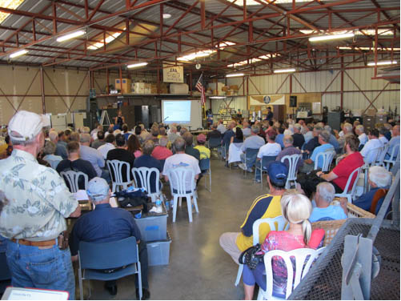
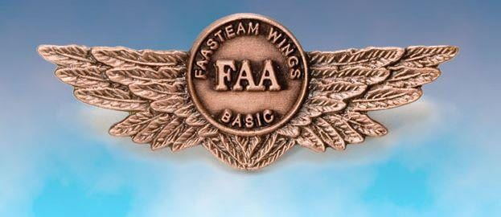

Thank you for attending
You are vital members of our GA safety community
Notes:
Your presence here shows that you are vital members of our General Aviation Safety Community. The high standards you keep and the examples you set are a great credit to you and to GA.
Thank you for attending.
(Next Slide)

Slide 30
The National FAA Safety Team Presents
Topic of the Month – July
Stabilized Approach and Go-around
<Audience>
<Presenter>
< >
Notes:
(The End)

