Slide 1
The National FAA Safety Team Presents
Topic of the Month - December
Flight Data Monitoring
<Audience>
<Presenter>
< >
Notes:
2023/10-29-296(I)PP Original Author: J. Steuernagle Mar 2024 POC: K Clover National Program Manager (Operations) Office 562-888-2020.
Presentation Note: This is the title slide for Flight Data Monitoring
Presentation notes (stage direction and presentation suggestions) will be preceded by a Bold header: the notes themselves will be in Italic fonts.
Program control instructions will be in bold fonts and look like this: (Click) for building information within a slide; or this: (Next Slide) for slide advance.
Some slides may contain background information that supports the concepts presented in the program.
Background information will always appear last and will be preceded by a bold Background: identification.
We have included a script of suggested dialog with each slide. Presenters may read the script or modify it to suit their own presentation style.
The production team hope you and your audience will enjoy the show. Break a leg!
(Next Slide)

Slide 2
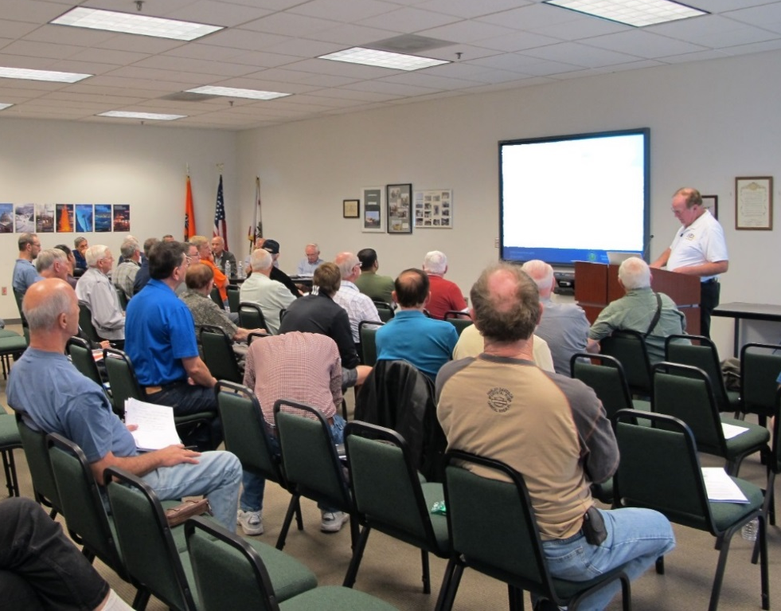

Welcome
Exits
Restrooms
Emergency Evacuation
Breaks
Phones & Devices to Silent or Off
Sponsor Acknowledgment
Other information
Notes:
Presentation Note: Here’s where you can discuss venue logistics, acknowledge sponsors, and deliver other information you want your audience to know in the beginning.
You can add slides after this one to fit your situation.
(Next Slide)

Slide 3
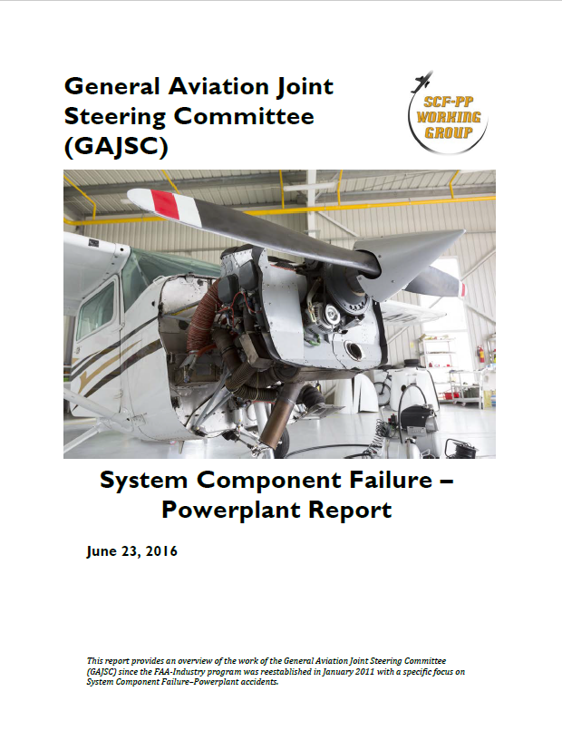
Overview
*GAJSC System/Component Failure Study
Safety Benefits of Flight Data Monitoring
Present & Future FDM Technologies
How GA pilots can use FDM today
*General Aviation Joint Safety Committee
Notes:
Recently, the GAJSC System/Component Failure Work Group released Safety Enhancements dealing with Engine Maintenance and Flight Data Monitoring. The work group feels that Flight Data Monitoring can help to identify emerging problems with aircraft systems and components and facilitate replacement or repair before failure.
We want to take just a few minutes to talk about best practices and the safety benefits of Flight Data Monitoring – a technology and process that’s now coming to General Aviation.
We’ll look at present & future FDM technologies, and we’ll talk about how to use FDM today.
Presentation Note: If you’ll be discussing additional items, add them to this list
(Next Slide)

Slide 4

Flight Data Monitoring
Notes:
Flight data monitoring has been around since before the jet age and modern airplanes make extensive use of the technology. Through Flight Data Monitoring, aircraft operators can develop optimal maintenance schedules, confirm aircraft performance expectations, and predict system or component failures before they occur. Flight Data Monitoring and Recording are also of great value in accident investigation.
(Next Slide)

Slide 5
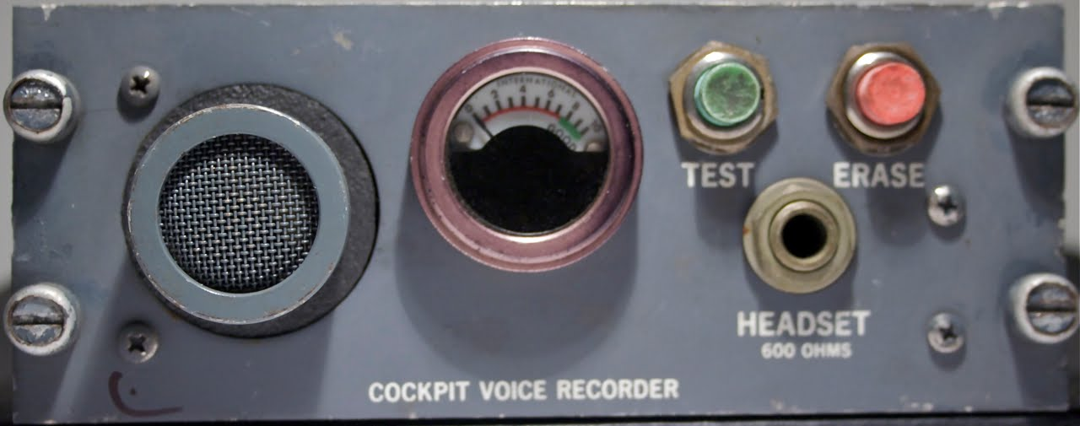
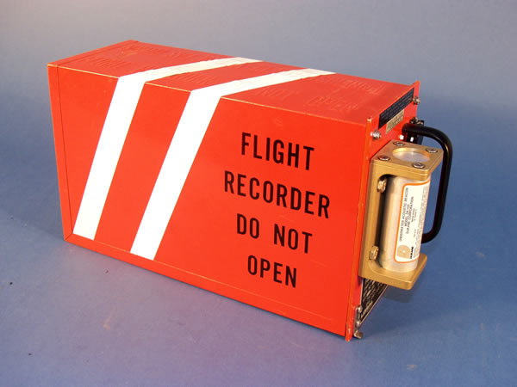
Flight Data Monitoring
FOQA
Cockpit Voce Recorder (CVR)
Flight Data Recorder (FDR)
Notes:
In its’ simplest form, FDM consists of a cockpit voice recorder that records at least the most recent 2 hoursof crew conversations, and a flight data recorder that preserves such things as engine parameters, control position, heading, altitude, and airspeed data. (Click)
The equipment and processes to acquire and distribute the data are collectively known as Flight Operational Quality Assurance or FOQA (pronounced: Foh-qua)
But this equipment is only for the big guys, right? General Aviation aircraft don’t have anything like this ……………………. Or do they?
(Next Slide)

Slide 6
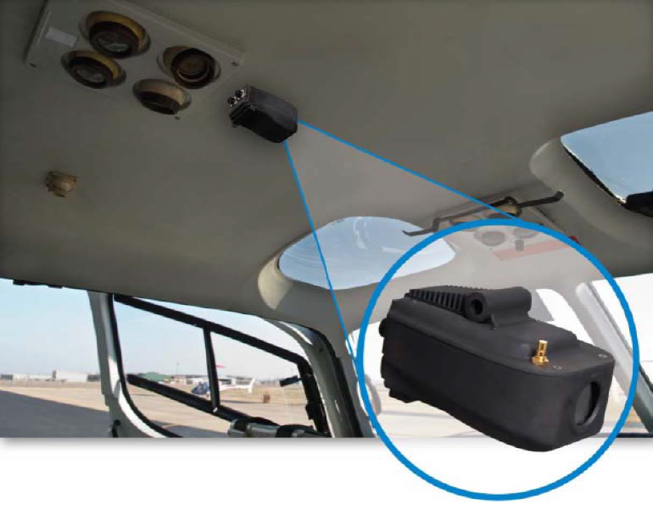
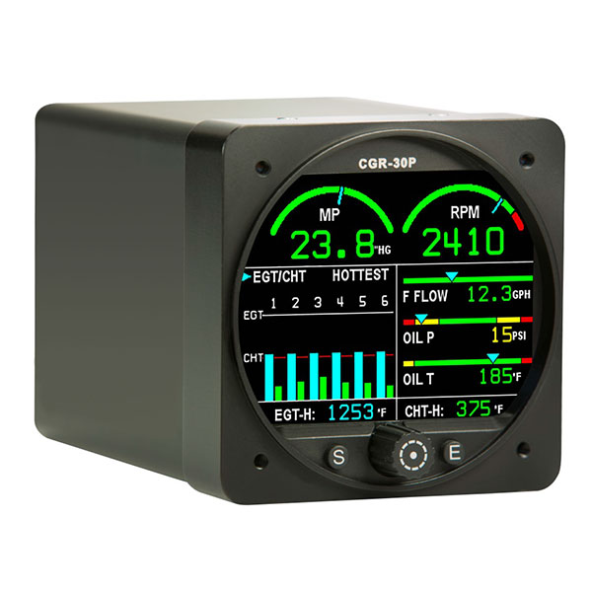
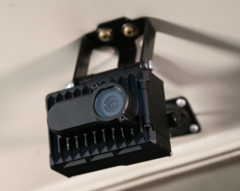
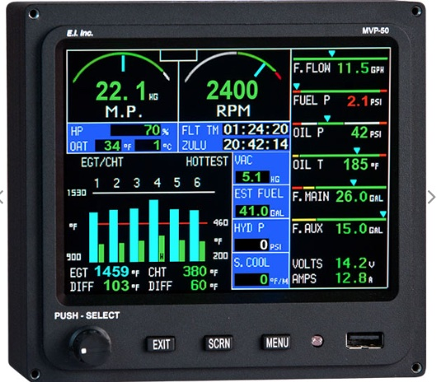
Flight Data Monitoring for GA
Flight Data
Flight Data + Visual
Notes:
While it’s true that most GA aircraft don’t have dedicated automatic flight data recording devices now; we will be able to enjoy the benefits of equipage in the future. In the meantime, it’s often surprising to see what we already have. (Click)
Manufacturers have been offering self-contained flight data recorders for GA airplanes and helicopters for some time Most operators of this equipment must periodically download and analyze the recorded data – often with the aid of dedicated computer programs. (Click)
We’re beginning to see recorders that capture video and audio in the cockpit. Some of these devices integrate GPS positioning with audio and video data. Like airline equipment they record on armored data drives that are periodically overwritten and on common compact storage media that operators can remove and review in their maintenance and flight departments.
(Next Slide)

Slide 7
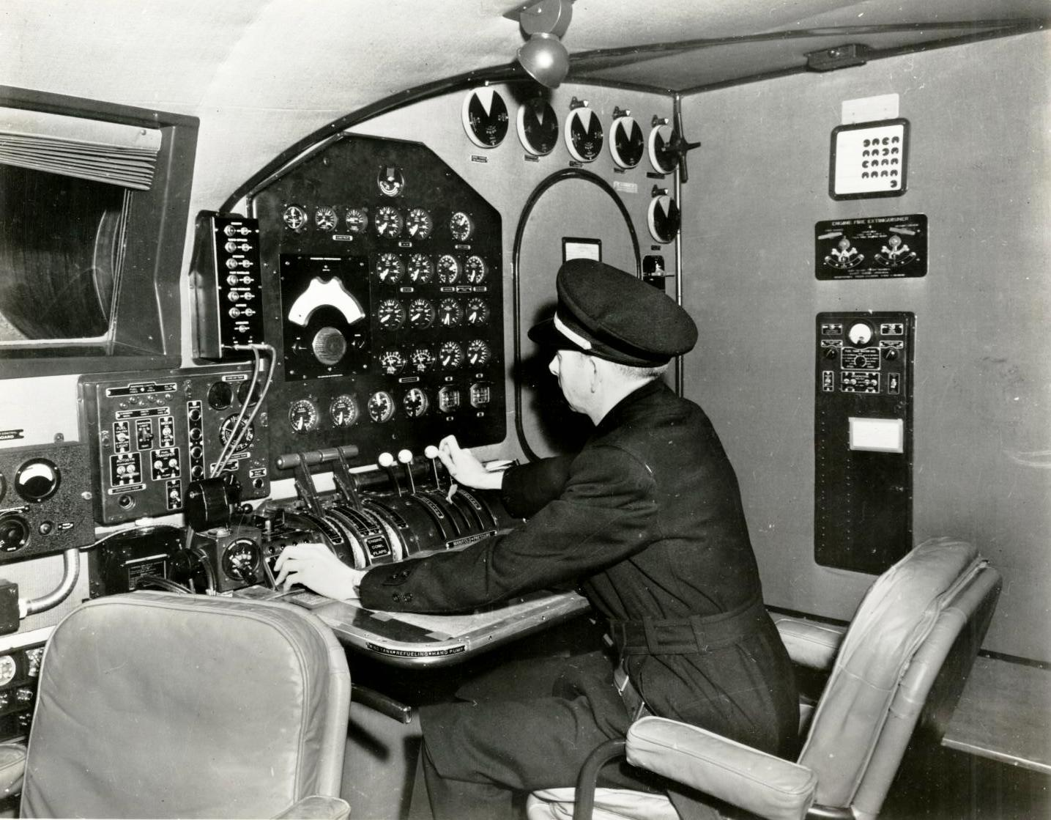
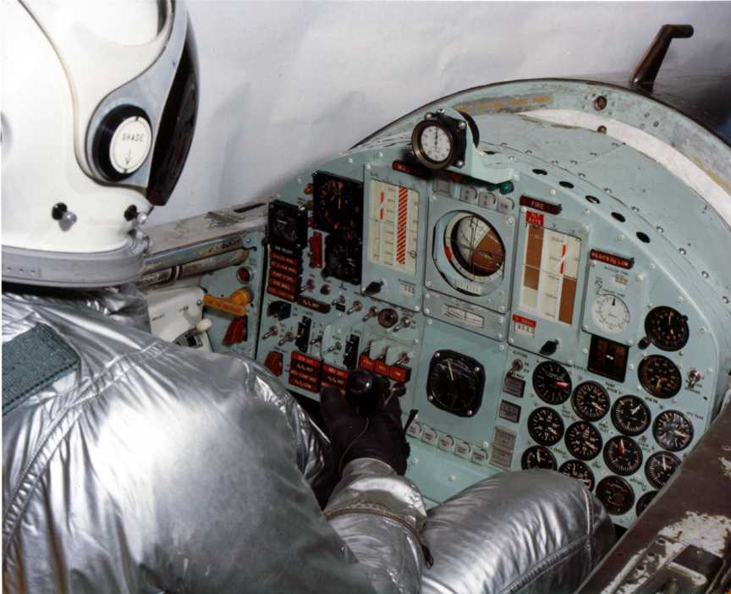
Flight Data Monitoring for GA
Notes:
Many data monitoring operations involve no automation at all. Flight engineers used to handle the monitoring and record keeping (Click)
And test pilots were expected to keep notes while flying.
(Next Slide)

Slide 8
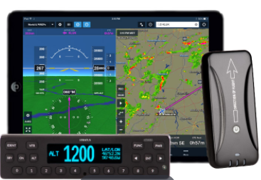

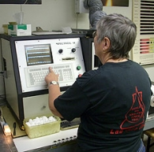
Flight Data Monitoring for GA
Notes:
GA pilots can do much the same thing by tracking engine power, fuel flow, oil temperature and pressure. Some GPS systems and engine monitors have recording capability, and many aircraft owners participate in oil analysis programs – a tool for gauging engine health and heading off expensive or, in some cases, disastrous problems. Some aircraft – particularly helicopters - are equipped with metallic chip detectors that can forecast engine and transmission failures in time to make a safe landing.
(Next Slide)

Slide 9
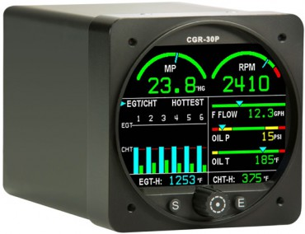
Sample of What's Available to the GA Community
PRIMARY ENGINE MONITOR SYSTEM
RPM M.P. EGT/CHT Bar Graph Oil Pressure Oil Temperature TIT Hydraulic Pressure C.O. OAT Vac. | Fuel Pressure Fuel Level Fuel Flow Fuel Remaning Fuel Used Fuel -GPS Related Data Low Fuel Alarm Recurring Fuel Alarm Volts Amps | Flight Timer Tach Timer Local Time Zulu Time Annunciators Data Recording USB Port External Caution Lights And More
Notes:
Here’s just one example of the information available in one small box. This example doesn’t include recording capability but it’s certainly one-stop shopping for engine information.
(Next Slide)

Slide 10
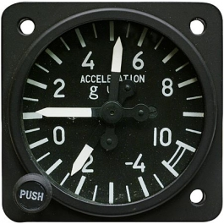
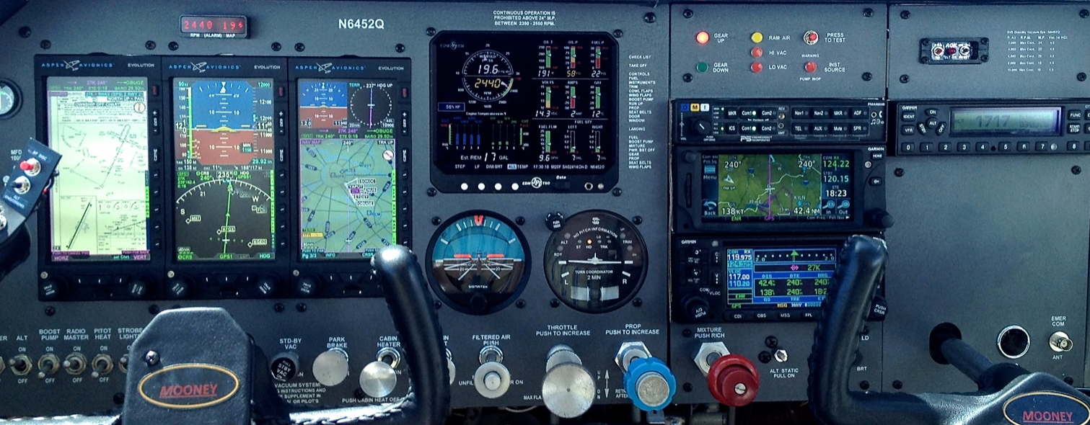
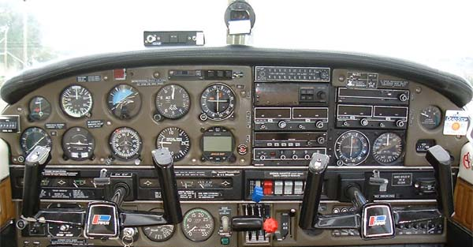
Flight Data Monitoring for GA
Notes:
And don’t forget basic instrumentation such as Air Speed Indicators, Attitude Indicators, Angle of Attack, Manifold Pressure, RPM, and G indicators – all of which give immediate feedback as to whether design limitations have been or are about to be exceeded.
(Next Slide)

Slide 11
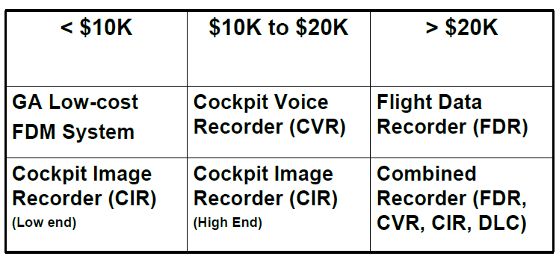
FDM Technology Cost
Notes:
At present FDM Technology costs from a little less than $10,000.00 to more than $20,000.00 but as competition and equipage increase, prices are expected to fall.
(Next Slide)

Slide 12


Flight Data Monitoring for GA
Notes:
In the meantime, we urge you to consider and share the information that’s already available on every flight. Just a few notes after each flight can become a record of aircraft and pilot performance. That record can become valuable in the Safety Assurance component of a Safety Management System. More about that in a minute but for now, are there any questions about what we’ve covered?
(Next Slide)

Slide 13

Questions?
Notes:
Presentation Note: You may wish to provide your contact information and main FSDO phone number here. Modify with
Your information or leave blank. (Next Slide)

Slide 14


Proficiency and Peace of Mind
Fly regularly with your CFI
Perfect Practice
Document in WINGS
Notes:
There’s nothing like the feeling you get when you know you’re playing your A game and in order to do that you need a good coach (Click)
So fly regularly with a CFI who will challenge you to review what you know, explore new horizons, and to always do your best. Of course you’ll
have to dedicate time and money to your proficiency program but it’s well worth it for the peace of mind that comes with confidence. (Click)
Vince Lombardi, the famous football coach said, “Practice does not make perfect. Only perfect practice makes perfect.” For pilots that means
flying with precision. On course, on altitude, on speed all the time. (Click)
And be sure to document your achievement in the Wings Proficiency Program. It’s a great way to stay on top of your game and keep you flight review current.
(Next Slide)

Slide 15
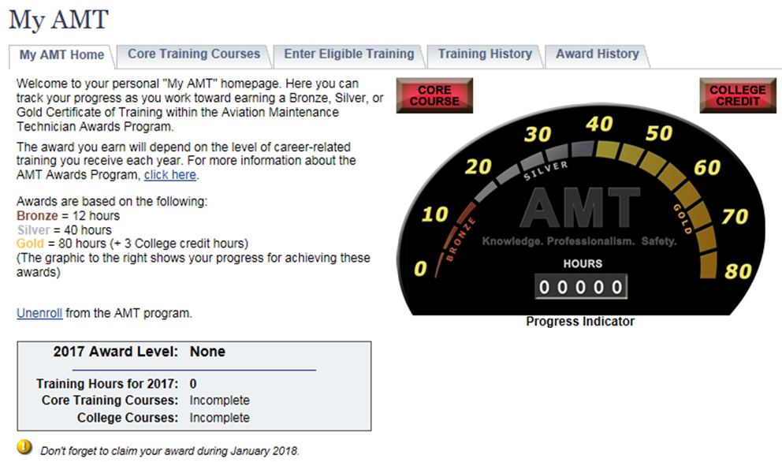
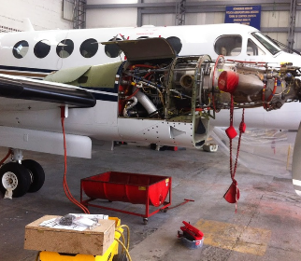
Training and Peace of Mind
Technical Training
Safety Related Training
Document in My AMT
Notes:
The Aviation Maintenance Technician Awards program encourages AMTs and employers to take advantage of initial and recurrent training by issuing awards based on training received in one calendar year.
The program has several levels, or phases, of recognition for both you and your employer. You can obtain an FAA Certificate of Training upon successful completion of the program requirements. Employers can obtain a Gold or Diamond Award of Excellence yearly depending on the percentage of their employees receiving awards.
Training earned toward an AMT Award falls into one of two categories; Mandatory Core Training and Eligible Training.
Mandatory Core Training is one or more on-line training courses, depending on FAA evaluation of training needs. The Core Training course(s) can be located and completed in the Aviation Learning Center at FAASafety.gov.
Eligible Training is the hourly training that can be credited toward an individual AMT Certificate of Training. This training must be aviation maintenance career related training.
Be sure to document your achievement in the AMT Awards Program. It’s a great way to stay on top of your game and keep stay proficient.
(Next Slide)

Slide 16
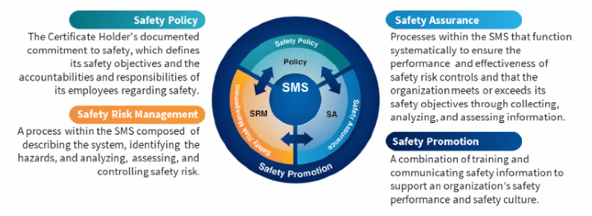

Safety Management Systems (SMS)
Coming to General Aviation
Safety Management System (SMS) | Federal Aviation Administration (faa.gov)
Notes:
Safety Management Systems are a set of policies and processes that can increase the safety and efficiency of any flight operation. And FAA is bringing SMS to General Aviation. You may have heard of SMS but thought it was only for large organizations but actually, SMS can be scaled to fit any operation large or small.
There are 4 major components to a Safety Management System (Click)
Safety Policy – a documented commitment to safety that runs from the head of an organization to its newest member. (Click)
Safety Risk Management – a process that identifies hazards within an operation, determines to what extent an identified hazard may impact flight safety, and controls the risk of occurrence to an acceptable level. (Click)
Safety Assurance – By collecting and analyzing information derived from safety performance data Safety Assurance ensures the performance and effectiveness of Safety Risk Controls. (Click)
Safety Promotion communicates safety information and commitment throughout the organization. (Click)
You can find more information about Safety Management Systems at the URL on the Screen.
(Next Slide)

Slide 17
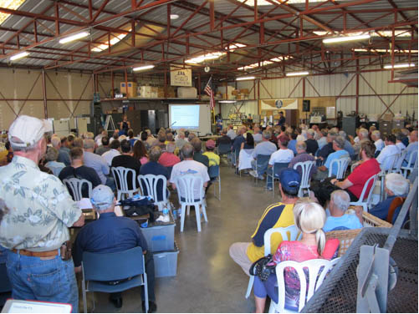

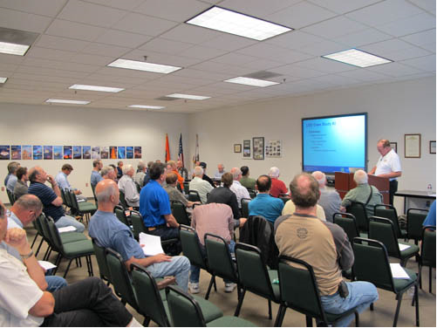
Thank you for attending
You are vital members of our GA safety community
Notes:
Your presence here shows that you are vital members of our General Aviation Safety Community. The high standards you keep and the examples you set are a great credit to you and to GA.
Thank you for attending.
(Next Slide)

Slide 18
The National FAA Safety Team Presents
Topic of the Month - December
Flight Data Monitoring
<Audience>
<Presenter>
< >
Notes:
(The End)

